Slide 1
Pressure Recovery in Aortic Stenosis
Dr. Benny J. Panakkal
Senior Resident
Dept. of Cardiology
Govt. Medical College, Kozhikode.

Slide 2
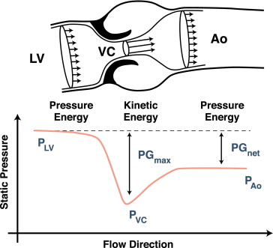
The basics

Slide 3
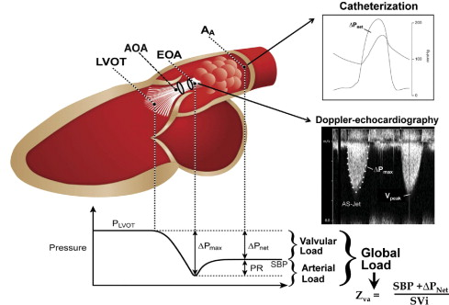
Interpretation
Notes:
PR due to either increased BP or smaller aorta.

Slide 4
Formulas

Slide 5
Research
20% reclassification of severe to moderate AS
ELI → incremental prognostic impact on future AVR, mortality
Notes:
JACC 2010 article

Slide 6
Summary
The most important determinant for the magnitude of pressure recovery that can occur downstream from a flow obstruction is the geometry of the stenosis and the receiving compartment.
Prosthetic valve, HOCM, Coarctation of Aorta.
It has been suggested that the extent of pressure recovery in aortic stenosis depends critically on the ratio of orifice area and cross-sectional area of the aorta because it determines the extent of flow separation and vortex formation

Slide 7
Causes of Syncope in Severe AS

Slide 8
Fixed cardiac output leading to reduced stroke volume.
High LV pressures leading to reflex bradycardia mediated via afferent C fibers
Reflex feedback inhibition of carotid body receptors by LV
Transient AV blocks
Transient AF/AFl

Slide 9
THANK YOU

